Slide 1

CREDIT CARD FRAUD DETECTION USING MACHINE LEARNING ALGORITHMS
Date: 09 April 2021
A G POOJA MANAS : 17WH1A0537
M.SREELEKHA : 17WH1A0553
K.PRIYANKA : 17WH1A0538
Internal Guide : Mrs G E Padmavathi
Designation : Assistant Professor
Department of Computer Science & Engineering
BVRIT HYDERABAD College of Engineering for Women

Slide 2

PROJECT INTRODUCTION
Why Should I Study this course?
Examples
Domain
Machine Learning
Problem Statement
It is vital that credit card companies are able to identify fraudulent credit card transactions so that customers are not charged for items that they did not purchase.The Credit Card Fraud Detection Problem includes modelling past credit card transactions with the data of the ones that turned out to be fraud. This model is then used to recognize whether a new transaction is fraudulent or not.
BVRIT HYDERABAD College of Engineering for Women

Slide 3

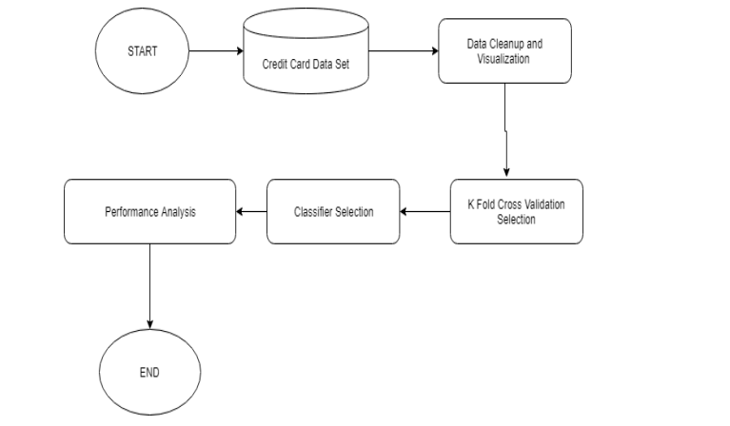
FLOWCHART
BVRIT HYDERABAD College of Engineering for Women

Slide 4
SYSTEM SPECIFICATIONS
ENVIRONMENT | SPECIFICATIONS
HARDWARE | Processor - Intel Core i5 Memory(RAM) - 8GB and more Storage - 1TB
SOFTWARE | OS - Windows 10 / Ubuntu Python3

Slide 5
REFERENCES
Base paper
https://www.ijert.org/credit-card-fraud-detection-using-machine-learning-algorithms
Dataset
https://www.researchgate.net/publication/315644460_Prediction_of_Occupational_Accidents_Using_Decision_Tree_Approach

Slide 6
Thankyou
BVRIT HYDERABAD College of Engineering for Women

